Slide 1
Pharmacist & Pharmacy technicians & assistant
Community
Hospital
Pharma Industry
Health Authority
Care Homes
GP Practice
Pharmacy Sectors

Slide 2
What do Hospital Pharmacist do?
https://www.rpharms.com/resources/careers-information/career-options-in-pharmacy/hospital-pharmacy
4 minute video

Slide 3
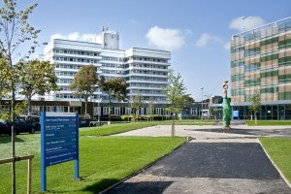
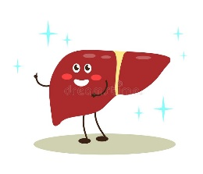
CLINICAL specialities
Hospital Pharmacy – Lister Hospital
730 bed district general
50 pharmacists – clinical specialists
Pharmacist for antimicrobials, education & training, Aseptic manufacturing, medicines information
Technicians and Assistants

Slide 4
Antimicrobial Pharmacist
Specialist pharmacist in hospital
Ensure all antibiotics in the hospital are prescribed appropriately for the right infection, at the right dose, and given at the right time.
Give advice to doctors and nurses when providing antibiotic treatment
Help combat antimicrobial resistance

Slide 5
eBug (https://www.e-bug.eu/)
Notes:
e-Bug (operated by PHE) is a free educational resource for classroom and home use and makes learning about micro-organisms, the spread, prevention and treatment of infection, fun and accessible for all teachers and students.
All activities and lesson plans have been designed to complement the National Curriculum eg. RSHE, Science. To find a selection of lessons to complement your chosen area, select from the tags below. You will also find a range of interactive activities to complement learning, including games, quizzes, and debate kits.

Slide 6
ICU Pharmacist
Ola – Intensive care pharmacist
Part of ICU team
Work with ICU doctors and nurses to ensure complex medication regimes are correct.
Peak of COVID19 pandemic

Slide 7
Medicines Review
1
2
Is the number of tablets patients took every day.
Is the number of tablets the patient took after a pharmacists review of all the medicines.
1
2

Slide 8
Pharmacy technician
https://www.bbc.co.uk/programmes/articles/1h8Rj5zZR2jGGwXcqlT2vmg/student-pharmacy-technician
Short video 1 minute 20 seconds

Slide 9
Community Pharmacists
Health advice - no appointment needed
Dispense prescriptions
Advice on medicine choices, drug interactions, side effects
Vaccinations – Flu, COVID19
Prescribing
Notes:
Community pharmacists were known in the past as chemists. Like GPs, community pharmacists are part of the NHS family. Every day about 1.6 million people visit a pharmacy in England.
Health advice - no appointment needed
On medicines, treatments and healthy lifestyles
89% population within a 20 minutes walk of a pharmacy
The traditional role of the community pharmacist as the healthcare professional who dispenses prescriptions written by doctors has changed. In recent years community pharmacists have been developing clinical services in addition to the traditional dispensing role to allow better integration and team working with nearby GP practices, drug and alcohol services, district nurses.
All pharmacist roles include advice on medicine choices, drug interactions, side effects

Slide 10
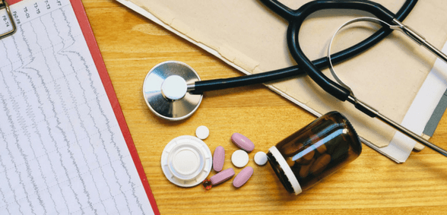
GP Practice Pharmacist
Clinics
Medication reviews
Prescribing
Training
Notes:
All GP practices now have access to a GP Practice Pharmacist
Clinics for patients such as with long term conditions such as diabetes, elderly
Medication review
Prescribe medicines
Training for other staff

Slide 11
Care Home Pharmacist
Checking correct medicines arrive with the patient
Regular review with doctors and nurses
Answer queries from care home staff
https://www.youtube.com/watch?v=h7gBvklCdFU

